Slide 1


INTRODUCTION
Class 01: Introduction to Data Science and AI/ML
PRESENTED BY [MD.SHARIAR EMON SHAIKAT]

Slide 2

Data Science Overview
Data Science is a multidisciplinary field that combines statistics, data analysis, and machine learning to extract insights from structured and unstructured data. It plays a crucial role in decision-making processes for businesses and organizations, enabling them to predict outcomes and improve efficiency. The key components of Data Science include data collection, processing, analysis, and visualization, which together help in deriving actionable intelligence and understanding complex phenomena.
The importance of Data Science cannot be overstated; it drives innovations in various sectors, such as healthcare, finance, and marketing. By leveraging algorithms and computational techniques, Data Scientists can uncover hidden patterns and trends in large datasets. Moreover, Data Science helps in automating processes and enhancing user experiences, making it an essential skill in the digital age. Its integration with AI and machine learning further amplifies its impact across industries.

Slide 3

AI Fundamentals
Understanding the essence of Artificial Intelligence
This illustration conveys the interconnectedness of AI systems and their role in simulating human intelligence through complex algorithms and data processing.

Slide 4

Machine Learning Essentials
Understanding the ML Workflow and Processes
This illustration captures the core components of machine learning, showcasing how data is transformed into insights through various algorithms.

Slide 5
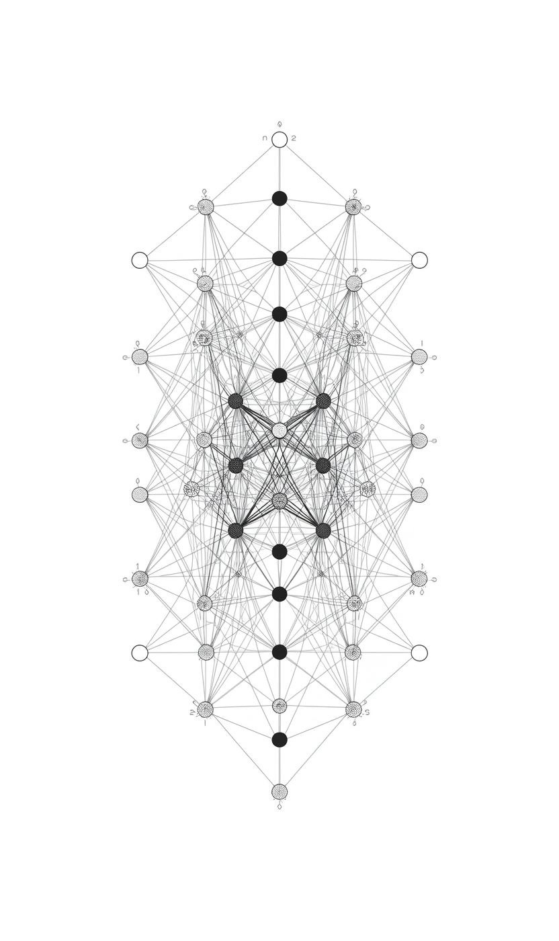
Deep Learning Overview
Understanding neural networks and their applications
This illustration represents the structure of deep learning, showcasing how multiple layers of neurons work together to process data effectively.

Slide 6

Learning Types and Algorithms
Supervised Learning: Definition and Examples
Supervised learning involves training models on labeled data, where input-output pairs guide the learning process. Common examples include regression and classification tasks.
Unsupervised Learning: Definition and Examples
Unsupervised learning explores data without labeled responses, aiming to identify patterns or groupings. Clustering is a primary technique used to uncover hidden structures in data.

Slide 7
Healthcare Diagnostics
Fraud Detection
AI algorithms analyze medical images, improving diagnostic accuracy and enabling early detection of diseases.
Machine learning systems identify fraudulent transactions in real-time, safeguarding financial assets and enhancing security measures.
Real-World Applications of AI/ML

Slide 8


Exploring Career Paths in Data Science
ML Engineering
Data Analyst
Develop and implement machine learning models for applications.
Analyze data to derive actionable insights for businesses.

Slide 9
Essential Tools
Platforms Overview
Begin your journey with tools like Python and Jupyter notebooks for hands-on coding and analysis.
Explore platforms such as Kaggle for datasets and competitions, enhancing practical skills in data science.
Hugging Face is a popular AI company and platform that provides tools, models, and datasets for machine learning, especially in natural language processing (NLP). It hosts a huge collection of pre-trained models that anyone can use, fine-tune, or deploy easily. Their Transformers library is widely used for tasks like text generation, translation, and sentiment analysis.
Tools and Platforms for Success

Slide 10
To support your understanding of Data Science and AI, focus on these foundational topics:
  Linear Algebra: Essential for understanding data transformations and machine learning algorithms.
  Statistics: Key for interpreting data and evaluating model performance.
Recommended resources include textbooks, online courses, and cheat sheets for continuous learning.

Slide 11
Understanding Linear Algebra and Statistics is crucial for mastering ML/AI. Key areas include:
  Linear Algebra concepts: matrices, vectors, transformations
  Statistics fundamentals: probability distributions, hypothesis testing, regression analysis
  Data manipulation: essential for algorithm implementation and data preprocessing methods
  Continuous learning: explore resources for deeper insights and applications in ML/AI.

Slide 12
Thank You for Joining Us
Email
semonshaikat702@gmail.com
Follow Us
Phone
www.linkedin.com/in/shaikat702
01946923532

